Slide 1

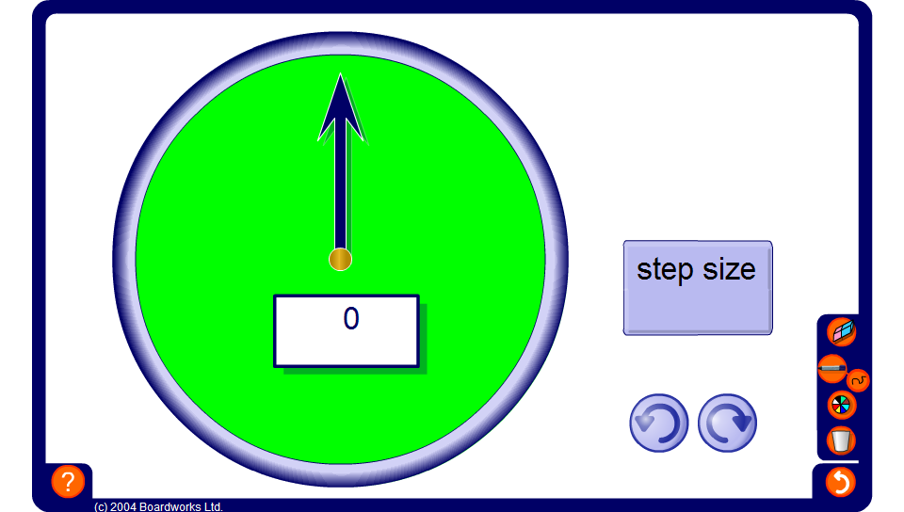


Fraction counter
Notes:
This counter can be used to count on and back in fractional steps. It can also be used to aid pupils to add and subtract simple fractions mentally.
Start by setting the step size to ¹/₅ and clicking the clockwise arrow once to show ¹/₅ on the board.
What is ¹/₅ + ¹/₅ ?
Click the clockwise arrow once to show ²/₅.
What is ²/₅ + ²/₅?
Press the clockwise arrow twice to move to ⁴/₅.
What is ⁴/₅ + ²/₅?
Press the clockwise arrow to move to 1¹/₅.
What is 1¹/₅ minus ³/₅?
We can think of 1¹/₅ as ⁶/₅.
⁶/₅ - ³/₅ is ³/₅.
Demonstrate this using the counter.
Next, set the step size to ¹/₄.
Use the counter to ask questions such as what is ‘¹/₂ + ¹/₄?’
Finally, spend some time counting on and back in ¹/₁₀s, ¹/₈s and ³/₄s. Link this to the addition and subtraction of simple fractions.

